Slide 1
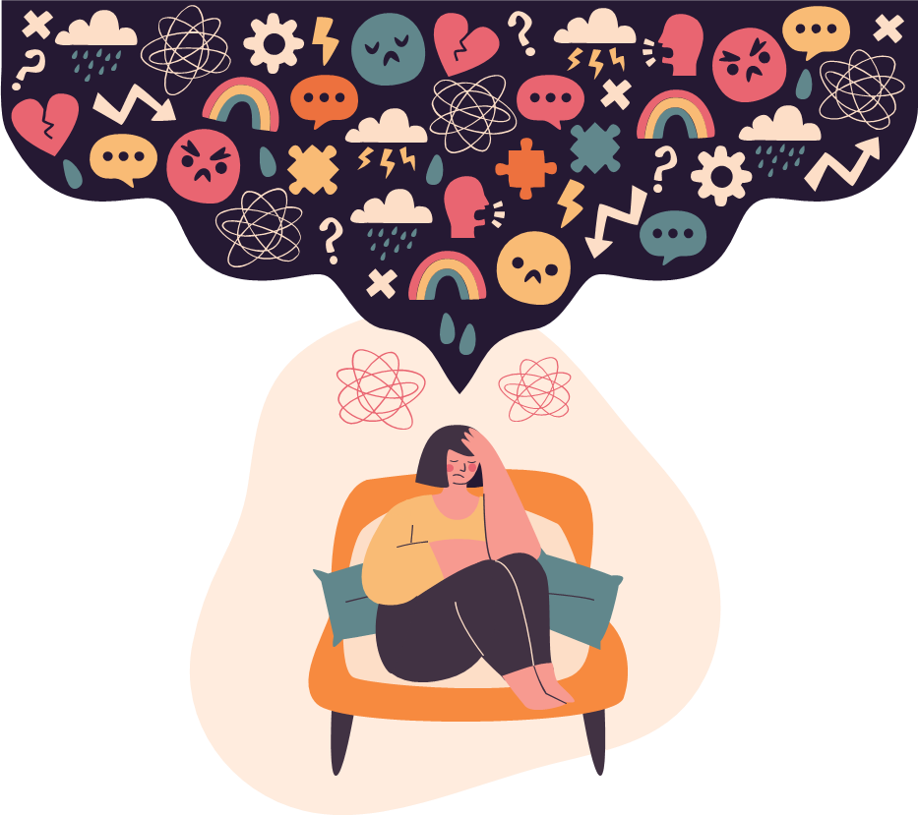
STRESS MANAGEMENT
Ms. Rabia Ijaz
Lecturer (Psychology)
Science and Humanities

Slide 2
Learning Outcomes
Understanding what stress is
Identification of stress triggers and implement de-escalation strategies
Ability to manage stress

Slide 3


Slide 4
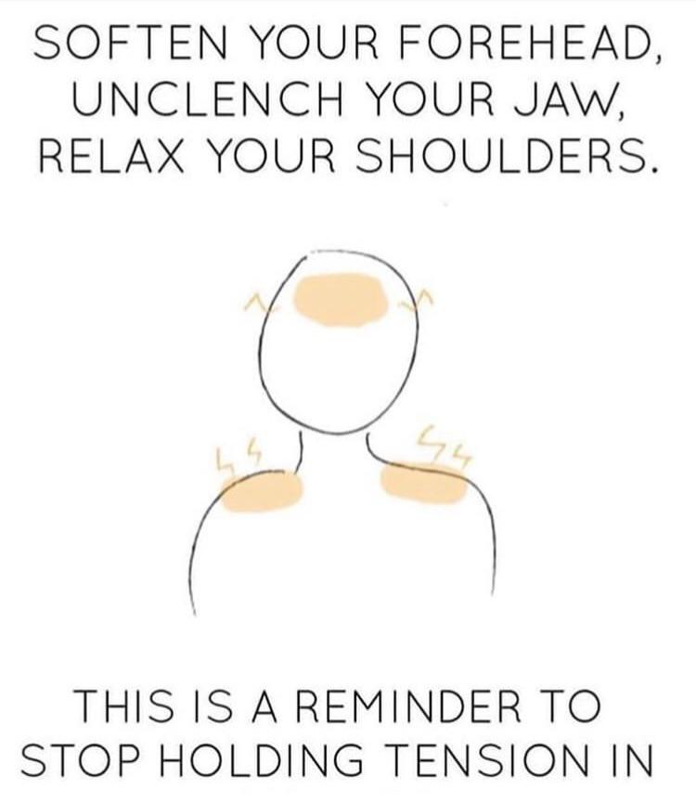

Slide 5

Stress Statistics
In APA’s Stress in America 2020 Survey, Gen Z is reported to be the most stressed generation, scoring an average Stress level of 6.1 on a scale of 1-10.
Gen Z stressors include high suicide rates (62%), relationship problems due to the pandemic (63%), changes in abortion laws (50%), and sexual harassment and assault in the news (58%).
82% of Gen Z members want more support, and it’s important to provide this through listening, promoting positivity, providing flexibility, maintaining social connections, and celebrating milestones creatively.
Gen Z is the newest generation, born between 1997 and 2012 as defined by the Pew Research Center.
They are currently between 9 and 24 years old.

Slide 6
Interpretation of online test
0-13
14-26
27-40
https://www.bemindfulonline.com/test-your-stress
Low Stress
Moderate Stress
High Perceived Stress

Slide 7
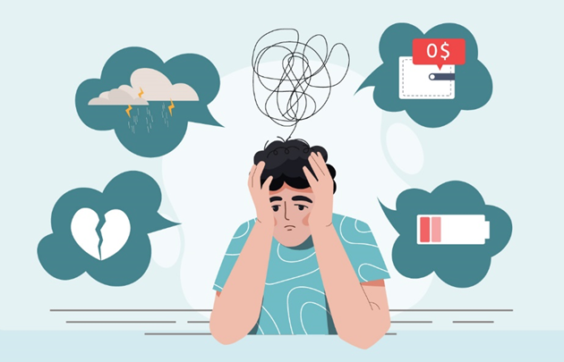
STRESS
Our mental, physical, emotional, and behavioral reactions to any perceived demands or threats.
Stress is not normally considered a mental health problem. But it is connected to our mental health in several ways.
Stress can cause mental health problems.
It can make existing problems worse.

Slide 8
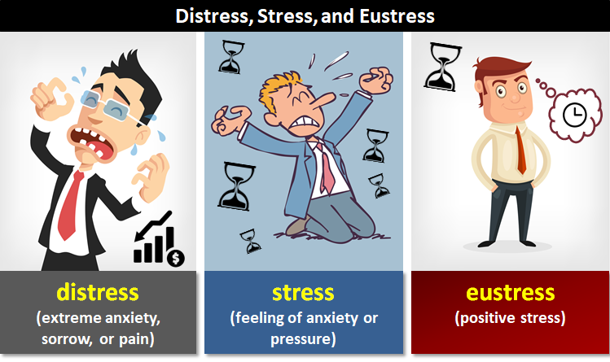
Types of Stress
EUSTRESS (GOOD STRESS)
Stress that is deemed healthful or giving one the feeling of fulfillment. It helps to produce personal growth or accomplishment. Research has shown that moderate levels of stress can actually improve your ability to concentrate and perform at your best.
1. Short Termed
2. Motivates, provides energy and increases focus
3. Excites the individual, feelings of excitement & anticipation
4. Creativity is heightened
5. Coping skills learned and adapted quickly
6. Ability to process information rapidly increases
7. Perception narrows, concentration increases
8. Heightened physical stamina

Slide 9
DISTRESS (BAD STRESS)
Stress that causes pain, suffering, trouble, danger, etc.
1. Can be short term or long term
2. Decreases performance
3. Demotivates the individual
4. Feelings of anxiety and uncertainty
5. Creativity is stunted
6. Coping skills are overwhelmed
7. Ability to process information is stunted
8. Perception narrows
9. Easily distracted by surrounding stimuli
10. Somatic symptoms

Slide 10

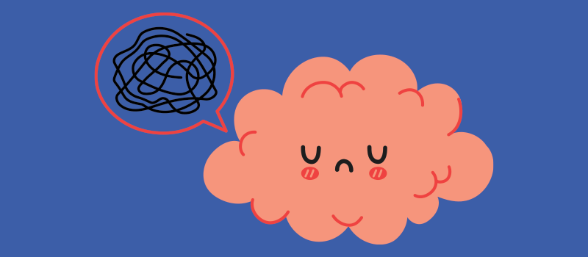
Eustress
Impact on Perception
Positive challenge
Impact on Emotions
Excitement
Impact on Productivity
Motivation
Impact on Performance
Enhancement
Distress
Impact on Perception
Impact on Emotions
Negative threat
Anxiety
Impact on Productivity
Procrastination
Impact on Performance
Decline

Slide 11
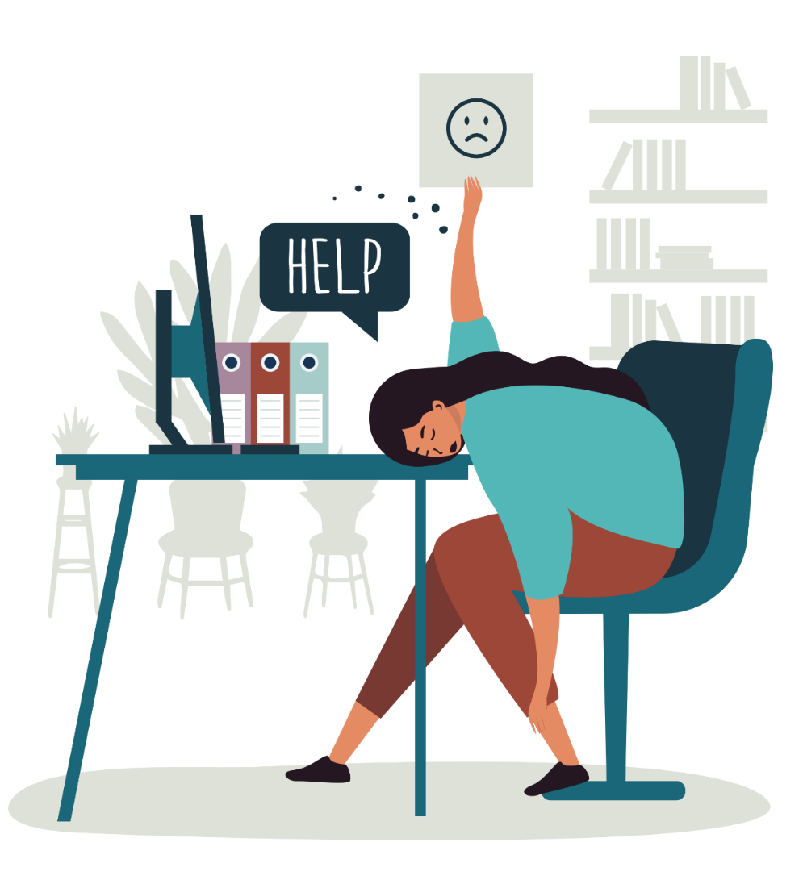
Stress is typically an emotional response caused by an external trigger, the STRESSOR
The trigger can be:
(a) Short-term
1. Work deadline
2. fight with a loved one
(b) Long-term
being unable to work
discrimination
chronic illness
People under stress experience mental and physical symptoms, such as:
Irritability
Anger
Fatigue
Muscle Pain
Digestive Troubles
Difficulty Sleeping

Slide 12
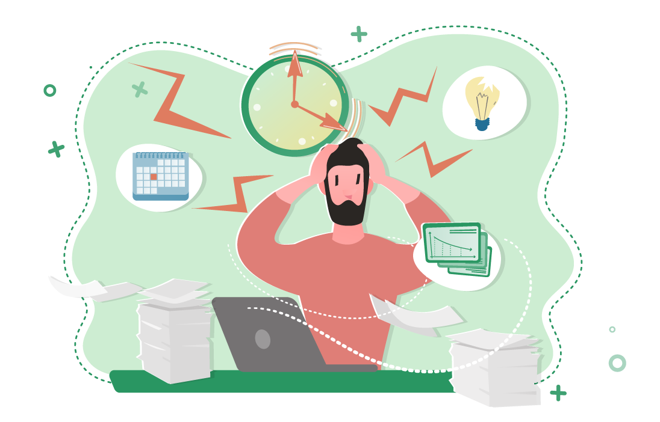
Stressors
There are many circumstances or events that can produce stress. The sources of stress are called stressors.
3 types of Stressors
1- Frustration
3- Life induced stress
2- Conflict induced stress

Slide 13
1- Frustration
Example: You can only buy one ice-cream out of two.
Example: Marriage, death of a loved one, divorced, change of schools, trouble with boss etc.
Life events that can be stressful
When some goals can be satisfied on the expense of others.
Blocking of goal directed behavior
Example: being stuck in a traffic jam can be very frustrating. Or light went off during paper.
2- Conflict Induced Stress
3- Life Induced Stress

Slide 14
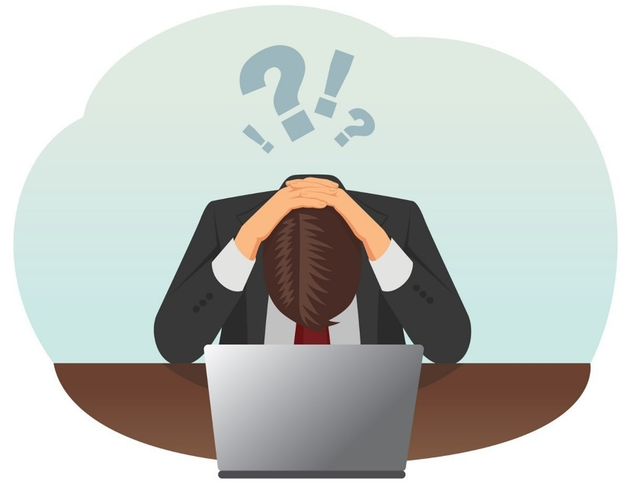
Why do we feel "Stressed Out"?
For two major reasons:
We perceive a situation as threatening, difficult, or painful.
We don't believe we have the resources to cope.
1. The unsettling effects of change
2. The feeling that an outside force is challenging or threatening you.
3. The feeling that you have lost personal control.

Slide 15
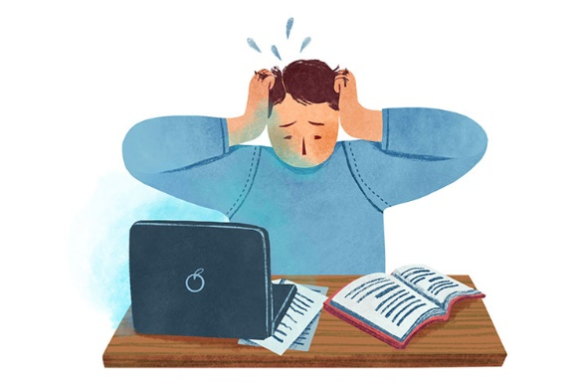
Stress hormones increase our heart rate blood pressure and blood sugar levels in stress.
Our bodies release these hormones in stress:
1. Epinephrine
2. Norepinephrine
3. Cortisol
CORTISOL: Adrenal glands secrete it. Long term stress response.
1.increases blood sugar
2.boosts energy
3.suppresses digestion
4.suppresses reproduction
5.suppresses immunity
6.increase weight and depression and anxiety

Slide 16
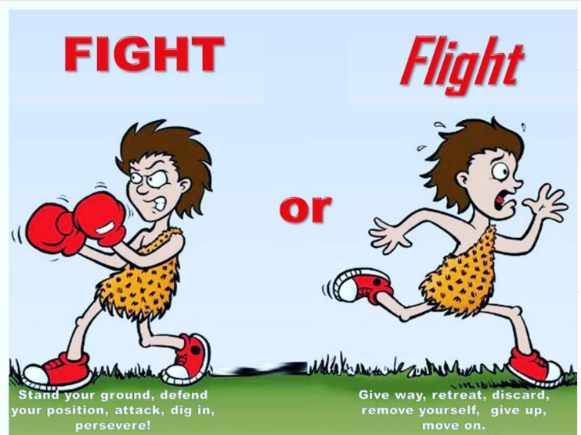
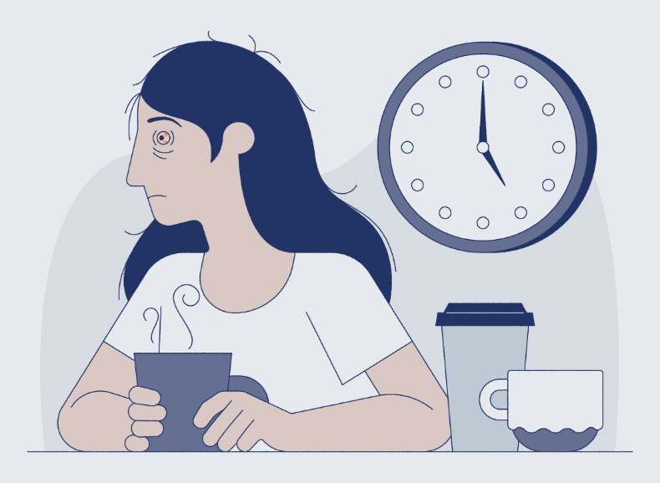
Epinephrine
1. flight and flight response
2. increases heart rate
3. boosts energy
4. provide the muscles with the oxygen
5. decreases body's ability to feel pain
Nor Epinephrine
1. alertness, vigilance
2. increases heart rate
3. irritability sleep deprivation
4. increases attention and focus on performing a task
5. fight or flight response

Slide 17
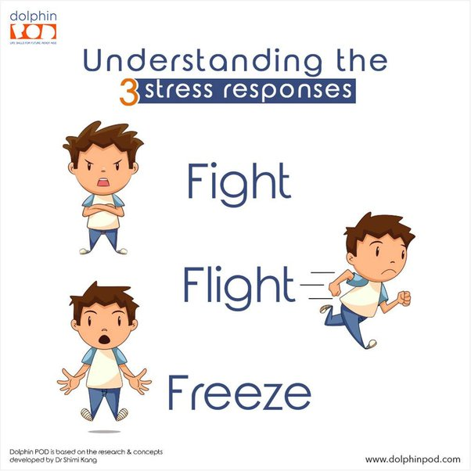
Have you noticed how your body reacts when you’re surprised or nervous about something? It’s trying to get you ready to properly react to the perceived threat.
This is your fight, flight, or freeze response, also known as the stress response. It’s a physiological reaction to something your body has perceived as a threat.
When activated, the stress response can make you react in three ways:
You fight the threat.
You flight from the situation.
You freeze and stay in place.

Slide 18
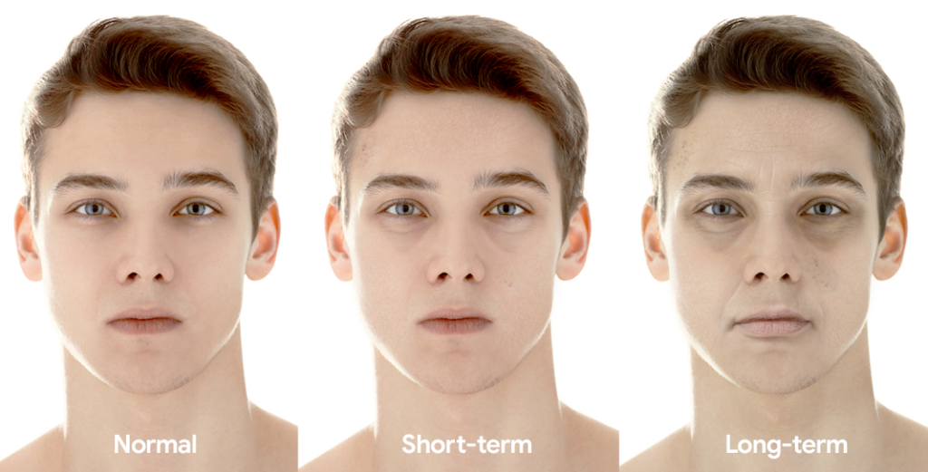
Just one week of sleeping fewer than six hours per night can lead to serious health issues, including the modification of over 700 genes, reports the Huffington Post on a study published in PNAS last year. Other symptoms of chronic sleep deprivation include everything from bloodshot eyes to quadrupled stroke risk.

Slide 19
Causes of Stress in student life
Increased academic demands
Being on your own in a new environment, Not getting enough sleep
Preparing for life after graduation, Financial responsibilities
Changes in your social life
Exposure to new people, ideas, and temptations, Too many things to do
Being lonely, Changes in family relations
The National Institute of Mental Health (NIMH) notes some of the more common stressors for college students:

Slide 20
Symptoms of Distress
Longer recovery from injury
Endocrine system problems
Sleep disturbances, whether it’s sleeping too much or an inability to sleep
Anxiety, Sweating palms/shaking hands
Immune system less efficient
Headaches
Fatigue
Gastrointestinal problems
Vulnerability to heart problems and hypertension (high blood pressure)
Inability to focus/lack of concentration

Slide 21
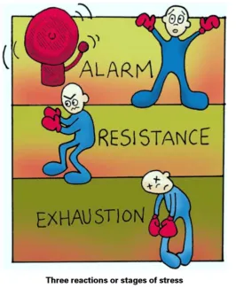
Stress as a physiological Reaction: Han Selye’s GAS (General Adaptation Syndrome)
Stressors produce a series of physiological reactions within us. The reaction to stressors occur in three stages:
Alarm
Exhaustion
Resistance

Slide 22
1. Alarm
The alarm reaction stage refers to the initial symptoms the body experiences when under stress. You may be familiar with the “fight-or-flight” response, which is a physiological response to stress. This natural reaction prepares you to either flee or protect yourself in dangerous situations. Your heart rate increases, your adrenal gland releases cortisol (a stress hormone), and you receive a boost of adrenaline, which increases energy. This fight-or-flight response occurs in the alarm reaction stage.
2. Resistance
After the initial shock of a stressful event and having a fight-or-flight response, the body begins to repair itself. It releases a lower amount of cortisol, and your heart rate and blood pressure begin to normalize. Although your body enters this recovery phase, it remains on high alert for a while. If you overcome stress and the situation is no longer an issue, your body continues to repair itself until your hormone levels, heart rate, and blood pressure reach a pre-stress state. Some stressful situations continue for extended periods of time. If you don’t resolve the stress and your body remains on high alert, it eventually adapts and learns how to live with a higher stress level. In this stage, the body goes through changes that you’re unaware of in an attempt to cope with stress.
Your body continues to secrete the stress hormone and your blood pressure remains elevated. You may think you’re managing stress well, but your body’s physical response tells a different story. If the resistance stage continues for too long of a period without pauses to offset the effects of stress, this can lead to the exhaustion stage.
Signs of the resistance stage include:
irritability
frustration
poor concentration
3. Exhaustion
This stage is the result of prolonged or chronic stress. Struggling with stress for long periods can drain your physical, emotional, and mental resources to the point where your body no longer has strength to fight stress. You may give up or feel your situation is hopeless. Signs of exhaustion include:
fatigue
burnout
depression
anxiety
decreased stress tolerance
The physical effects of this stage also weaken your immune system and put you at risk for stress-related illnesses.

Slide 23
Example
Zehra is a college student in the middle of her semester, she is strongly motivated to do well in her semester. One day she receives a call from her home that her friend is admitted in hospital She leaves college and drives for 16 hours to hospital. Her friend is admitted, the shock and disbelief is very overwhelming for Zehra’s initial alarm stage reaction.
Resistance stage: As her friend shows signs of recovery, but still will be admitted in the hospital for 3 days. There is little help Zehra can do about it and she feels she cant leave the situation and go back to college now. Every day she stays at hospital, she gets further behind in her classes.
Zehra becomes more sensitive to her problems as she feels stuck. With time, she becomes vulnerable to physical disease or infections like respiratory difficulties, skin rashes high BP. If Zehra can not find any useful way to deal with the stress she is experiencing, her physical reaction on the still-present stressors may be exhaustion.
At this stage, her bodily resources are nearly depleted. She is running out of time and energy. She may break down psychologically-example depression or physically or both. In extreme situations if the exhaustion stage remains for a long time like years, can lead to death

Slide 24
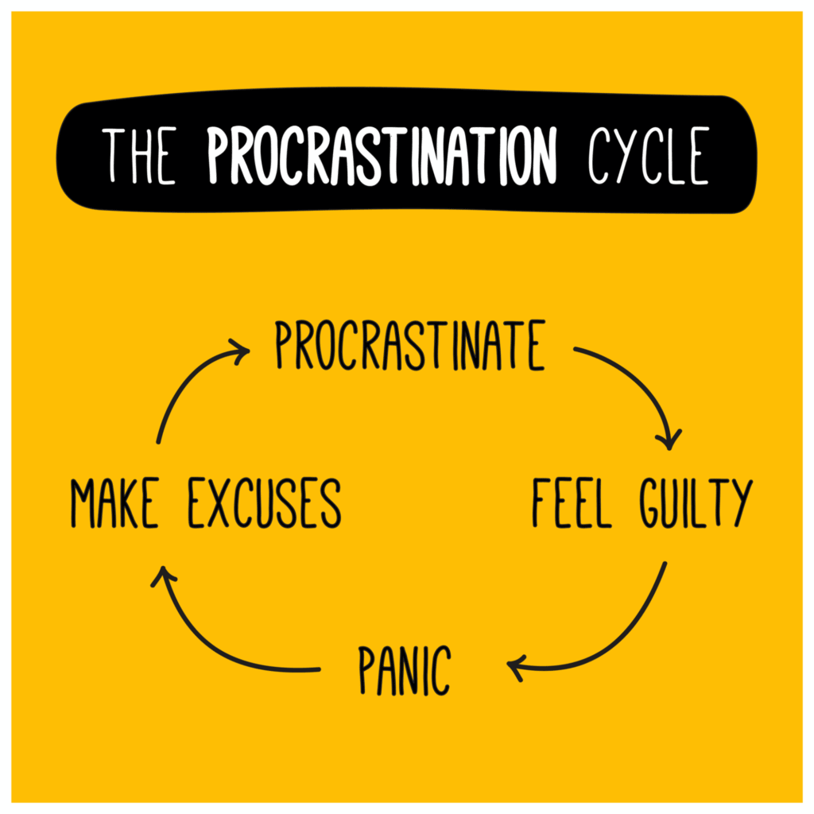
Ineffective strategies to deal with stressors

Slide 25

How stress affects your brain
Notes:
https://www.youtube.com/watch?v=WuyPuH9ojCE

Slide 26
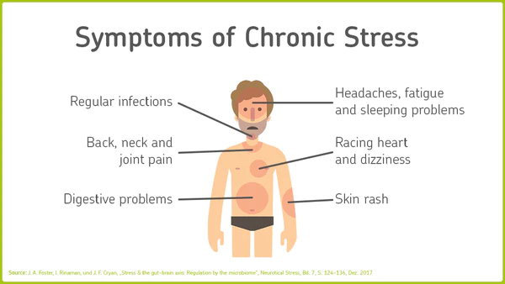
The long-term activation of the stress response system and too much exposure to cortisol and other stress hormones can disrupt almost all the body's processes. This puts you at higher risk of many health problems, including:
Anxiety
Depression
Digestive problems
Headaches
Muscle tension and pain
Heart disease, heart attack, high blood pressure and stroke
Sleep problems
Weight gain
Problems with memory and focus
That's why it's so important to learn healthy ways to cope with your life stressors.

Slide 27
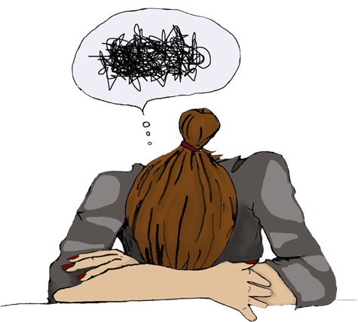
How to deal with stress

Slide 28
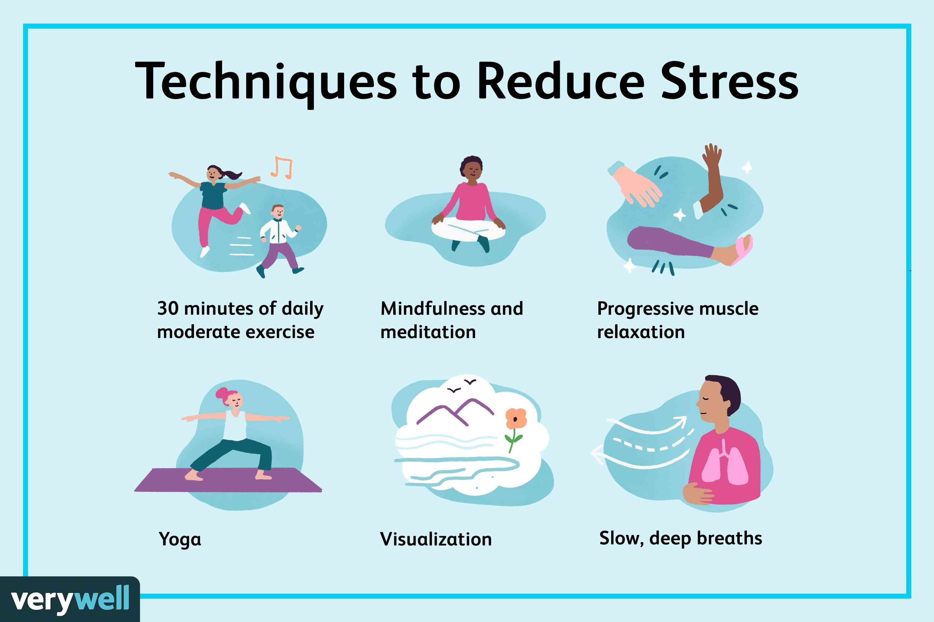
Effective strategies for coping with stressors
Identify the stressor
Reappraise the situation
Learn techniques of relaxation
Engage in physical exercise
Seek social support

Slide 29

When you know stress is coming, imagine yourself coping effectively
Only cope ahead for thing you know are coming (not "what ifs?")
Steps to cope ahead
Describe the situation
Imagine the situation
Imagine ways of coping effectively
Imagine problems that could be barriers to coping effectively
Imagine coping effectively with those barriers

Slide 30

Deep Breathing Exercise

Slide 31
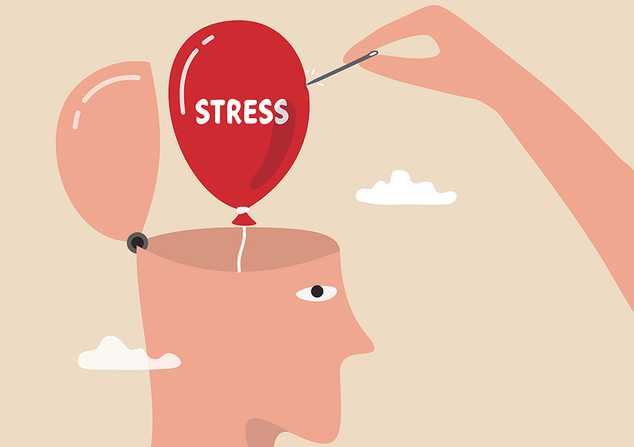
Dealing with Stressful Situations: The Four A’s
Change the situation:
Avoid the stressor.
Alter the stressor.
Change your reaction:
Adapt to the stressor.
Accept the stressor.

Slide 32
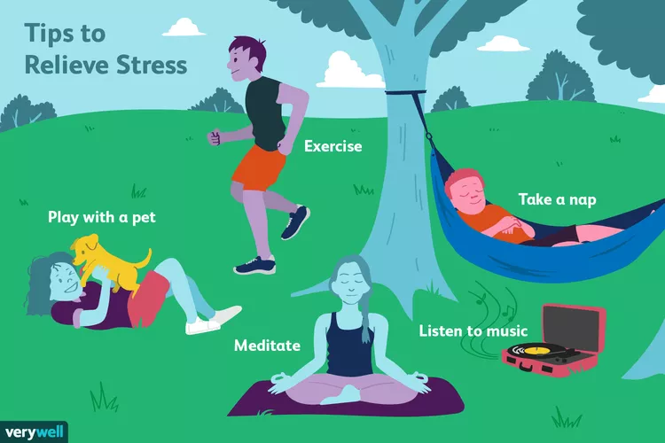
Healthy Ways To Relax And Recharge
Go for a walk.
Spend time in nature.
Call a good friend.
Sweat out tension with a good workout.
Write in your journal.
Take a long bath.
Light scented candles

